Slide 1

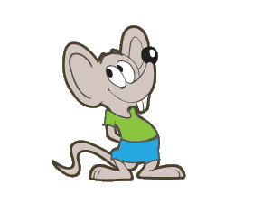
Species’ Needs
Taxonomy
Life history
Habitat
Ecological Needs at
Individual level
Population level
Species level
Notes:
Yesterday we covered the first few components for developing the SPECIES NEEDS section of an SSA analysis (FIVE clicks).
Today, we will continue by scaling up to Population level needs (click) and finally, Species needs (click).

Slide 2
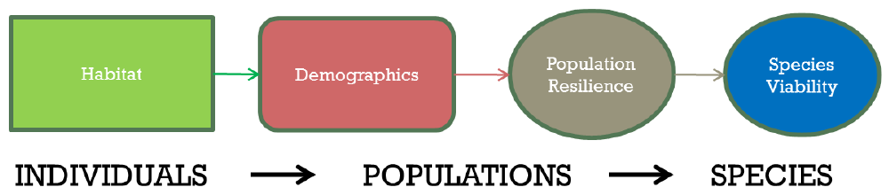
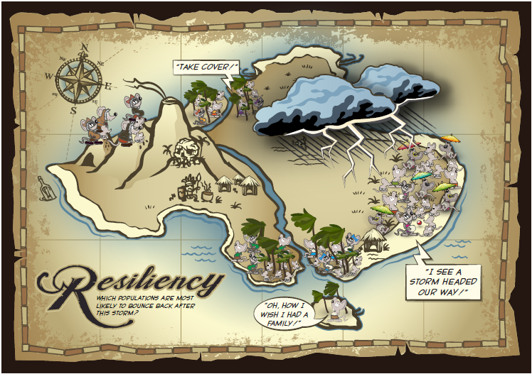
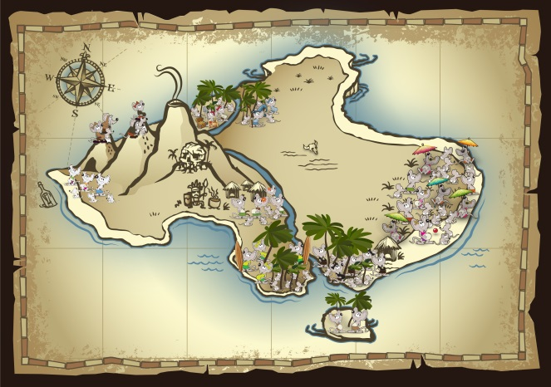
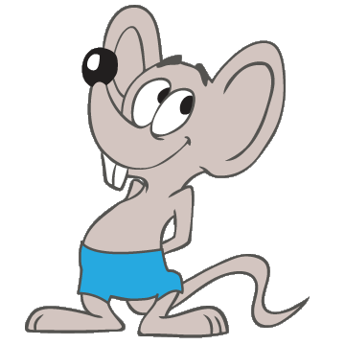
Species’ Needs
Notes:
What we mean by “needs” is understanding how the ecological system works for the species to complete it’s life history and maintain resilient populations across its range.
This our “bare bones” influence diagram of how an ecological system works for a species.
Each box is a “node” and arrows indicate how one node (origin of the arrow) effects another node (the arrow point). The color of the arrow simply indicates which node (of like color) the arrow originates from. This color coding will be beneficial once the model diagram gets more complex.
It begins with “habitat” (the green box) or particular sets of physical and biological environmental resources that support the species. We now have a list of these for the Island Mouse (from Exercise 2 – point to the comprehensive poster on the wall). What were the six resource needs that we identified as most important to individuals yesterday? (just review those six).
The “Demographics” box represents what populations require for completing their life history needs. (…and we know the Island Mouse’s basic life history from Exercise 1).
Habitat supports the demographics to provide for each resilient POPULATION.
When we talk about the demographics, we think about the number, distribution, and diversity of the populations (population resilience – grey oval) – that helps determine the overall, rangewide viability of the species (blue oval).
This is where we will be headed today!

Slide 3
Species’ Needs
Conceptual models can be useful
Structure the assessment
Identify the inputs and outputs of the assessment
Lend transparency and explicitness
Help communicate a common understanding
Basis for making forecasts
Answer the “so what does it mean for the species?” question
Notes:
We will begin to create a basic influence diagram, or conceptual model, for the Island Mouse this morning. The Conceptual model helps structure the assessment, it lends transparency and explicitness, and creates a basis for making forecasts. (Remember yesterday, we suggested that a good time to brainstorm this is at the first informal information-sharing meeting with experts.)

Slide 4
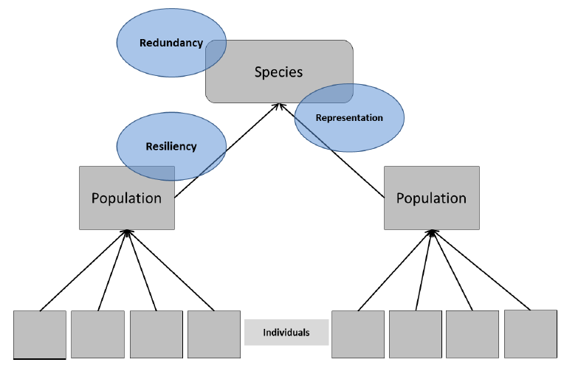
Species’ Needs
INDIVIDUAL
Notes:
Looking at it conceptually, (click) we did this level: INDIVIDUAL NEEDS, developing the life history profile and individual resource needs. The life history profile describes survival and reproduction needs (breeding, feeding, and sheltering) at the level of the individual, by life stage.
At the POPULATION level (click), we describe the resources, circumstances, and demographics that most influence the resilience of a population. (Refer back to the poster on the wall and repeat that RESILIENCE is the Mouse’s ability to bounce back after a stochastic event such as an Annual Storm, measured by the size & growth rate of each population.)
The resources, circumstances and demographics may vary if populations inhabit different ecological settings. What are the ecological settings for the Island Mouse? (Mountain, Paradise Palms, Coastal)
It is important to understand and determine for the analysis how populations should be defined for the species…for some, identifying population structures such as metapopulations may be helpful…and necessary. It is not always easy, though. Elaborate…but not too much!
For this week’s exercises, we have DEFINED a nice clean population structure!
The “Definition” of POPULATION is on page 20 of the SSA Framework doc. Have them pull it out and look at it?

Slide 5
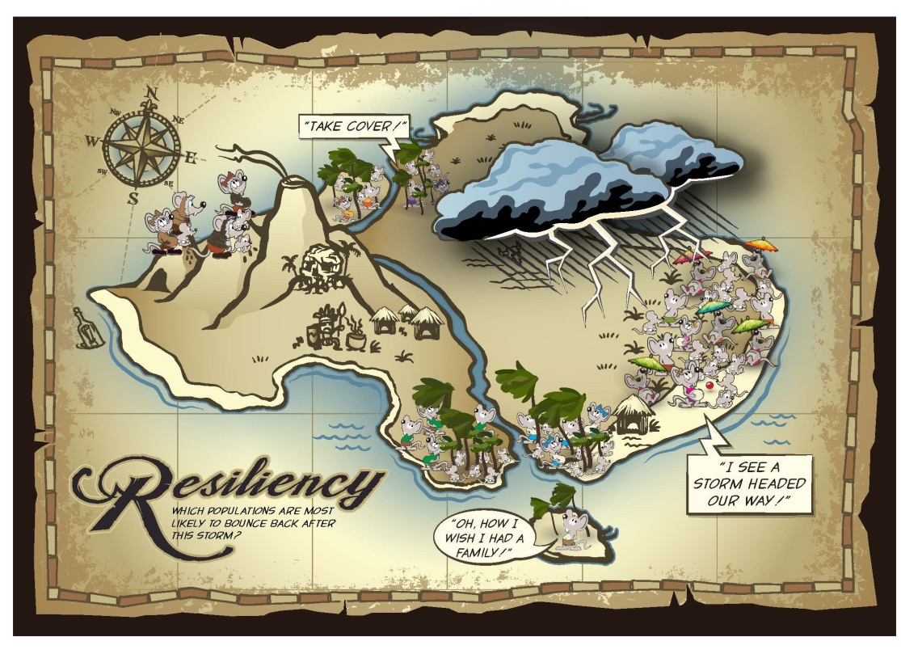
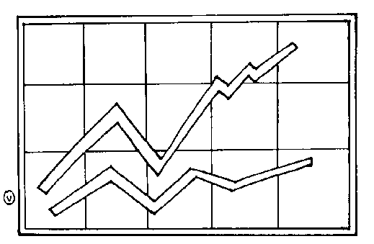
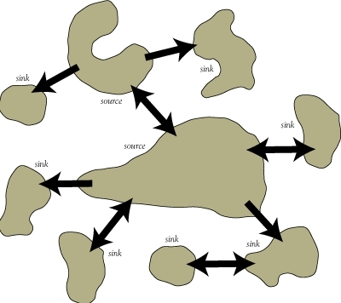
Species’ Needs
POPULATION
Ecological
Needs –
Populations
Notes:
So, the question we are focusing on now is, “what does our population NEED to be able to withstand stochastic disturbances?”
The resilience of a population is positively related to population size and growth rate (click). It may also be influenced by connectivity among populations (click)
So, generally speaking, populations need abundant individuals within habitat patches of adequate area and quality to maintain survival and reproduction in spite of disturbances.

Slide 6

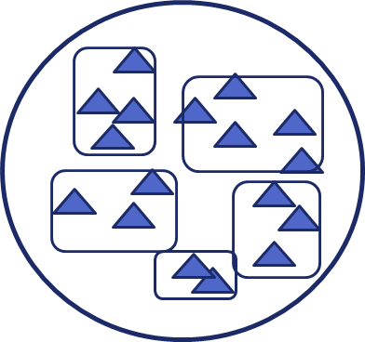
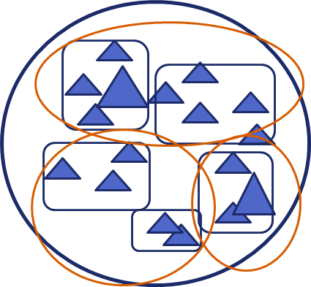
Defining Population Structure
Species’ Needs
POPULATION
One population
Multiple Populations
Metapopulations
= individual
Notes:
First we need to understand what a population is. THIS PART IS NOT EASY! We will not go into a lot of detail on defining populations in this course.
Defining Population Structure
An important but at times uncomfortable step is to determine the population structure of your species and actually define them on a map or in some other way. You need to know what your “common currency” is.
Define
No population structuring – panmictic population, species = one population.
Population structuring – species composed of distinct geographic units of individuals; they individuals share space, resources, and interact. Most species.
Further structuring – broader, these individual populations may interact with other populations to form metapopulations (pops of pops). Could be a small spatial scale, like KBB or larger like Ibat RU.
Core satellite or patchy populations? Isolated? Source/sink?
Now,
Describe.
This information can be part of the next stage – current condition, where you will want to document historic/past population numbers and distribution. In the Species Needs stage, try to figure out what population structure does your species NEED to persist (not what it has).

Slide 7
Species’ Needs
POPULATION
Core Conceptual Model
Notes:
So, now that we have a basic idea about what population structure our species NEEDS, we can start developing the core conceptual model to show the influence of habitat and demographics on population resilience.

Slide 8
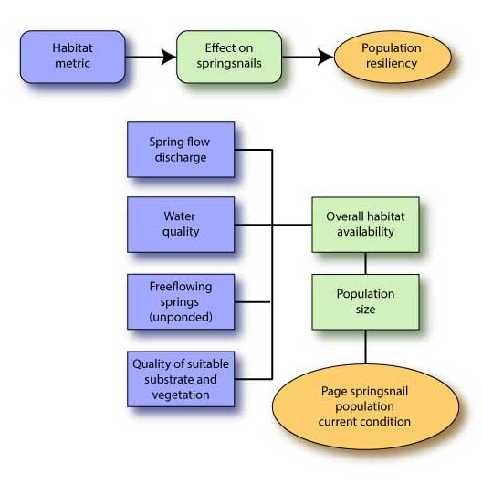
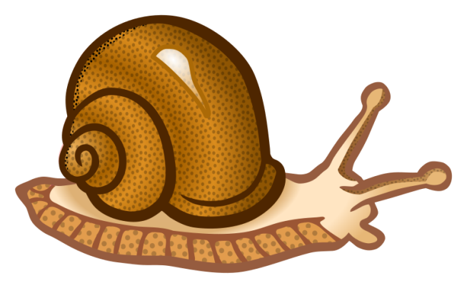
Notes:
Let’s look back at the Page Springsnail case study…
What were the HABITAT METRICS identified that influence population resilience? (click) They are right here in blue…
-Spring flow discharge
-Water quality
-Freeflowing springs (unponded)
-Quantity of suitable substrate and vegetation.

Slide 9
Core Conceptual Model
Species’ Needs
Habitat
Demographics
Population Resilience
Notes:
Given a small subset of our core model, lets think about how we can develop it to understand more about what our population needs. The population needs to be resilient. What demographic characteristics contribute to a resilient population?

Slide 10
Species’ Needs
CCM with Demographics Expanded
Population recruitment
Habitat
Population Abundance
Population Resilience
Adult Survival Rates
Notes:
This view expands the Demographic Node into three inputs.
Survival = adult annual survival, includes not emigrating, or being taken by anthropogenic actions
Population Abundance = what are the number of individuals (breeding pairs, etc.) in the population
Population growth rate = what is the rate of growth of each population
There are subinputs that may be useful to add, if they are drivers of pop persistence, such as juvenile survival, which may have through research been shown to drive X….

Slide 11
CCM with Habitat Expanded
Species’ Needs
Habitat Distribution
Demographics
Population Resilience
Habitat Extent
Habitat Connectivity
Habitat: physical and biological resources for individuals to complete their life history.
Notes:
Ok, now lets look at Habitat expanded. This view expands the Habitat Node into 3 possible inputs. 1) General habitat values (or resources) that we are interested in: quantity, quality, connectivity. These could be the Resource Needs that you developed in Exercise 2.
You could have more - competition, and depredation.
Each of these will influence the demographics of the species.

Slide 12
Species’ Needs
POPULATION
EXERCISE 3.
Population
Scale Needs
Notes:
Before sending the class into their population groups, the instructor will demonstrate how to start the basic conceptual model in Exercise 3 on a marker board or flip chart.
Ask the students to remember the six most important Resource Needs (RN) from Ex 2.
What is #1? (Beetles) Instructor draws a box to represent the RN (the green habitat metric box from the conceptual model).
What is the FUNCTION of that RN? Feeding. Draw that box to the right with an arrow.
What Demographic characteristic does beetles > feeding contribute to? (answer could be #individuals) Does everyone agree that # of individuals is an important demographic characteristic that contributes to population resiliency?
(This is the example that is pre-populated in Exercise 3, page 5).
Notice that we added a column for Resource Functions from Ex 2. There is no ONE way to do a conceptual model. Adding the resource function helps us as we begin to create a model for this species. (you can always take it out later…)
In population groups and using the interactive maps, answer Exercise 3 questions, complete a basic conceptual model for what you know right now, and fill out the Population Needs Table on p.6.
REPORT OUT by posting the Tables on the wall map at their population location (each population group will transcribe their information from their workbook to a color-coded card for posting). This then gives us a complete map of what all of the populations need, so we can then scale up to SPECIES.
Gallery Walk – take a break and encourage groups to look at what the other populations have posted on the map.

